Slide 1
1.1 Policy travel
Conceptual Grammar for Analysing Policy Movement
WG1: Corina, Freya, Que Anh, Sina, Sintayehu

Slide 2
Similarities and Differences
Howlett M. et al. (2009) 3rd edition | Peck J. et al (2010, 2011)
To develop an analytical framework …to study public policy | Focus on critical policy studies (especially policy in motion)
Political and economic approaches to the study of public policy | Geographical approach to the issues of policy transfer and transformation
Conceptual and theoretical aspects of public policy in general | Constitutive sociospatial context of policy making activities
Historical overview of the emergence and objectives of the policy sciences as a discipline itself | Transdisciplinary: geography, anthropology, political science, comparative political economy, political sociology
Policy process: five-stage policy cycle

Slide 3
Similarities and Differences
Howlett M. et al. (2009) 3rd edition | Peck J. et al (2010, 2011)
Positivist approach to policy analysis: rational, empirical, technical | A social-constructivist understanding of policy mobilities and mutations
Post-positivist approach: subjective reflections, normative analysis, different values and interests, argumentation | Post-positivist: problematise politics of knowledge and practice
Policy process as making rational choice | Policy formation and transformation as socially constructed processes, power relations and shifting ideological alignments
Policy actors, ideas, social & political structures | Connections between policy actors and policymaking sites through global networks

Slide 4
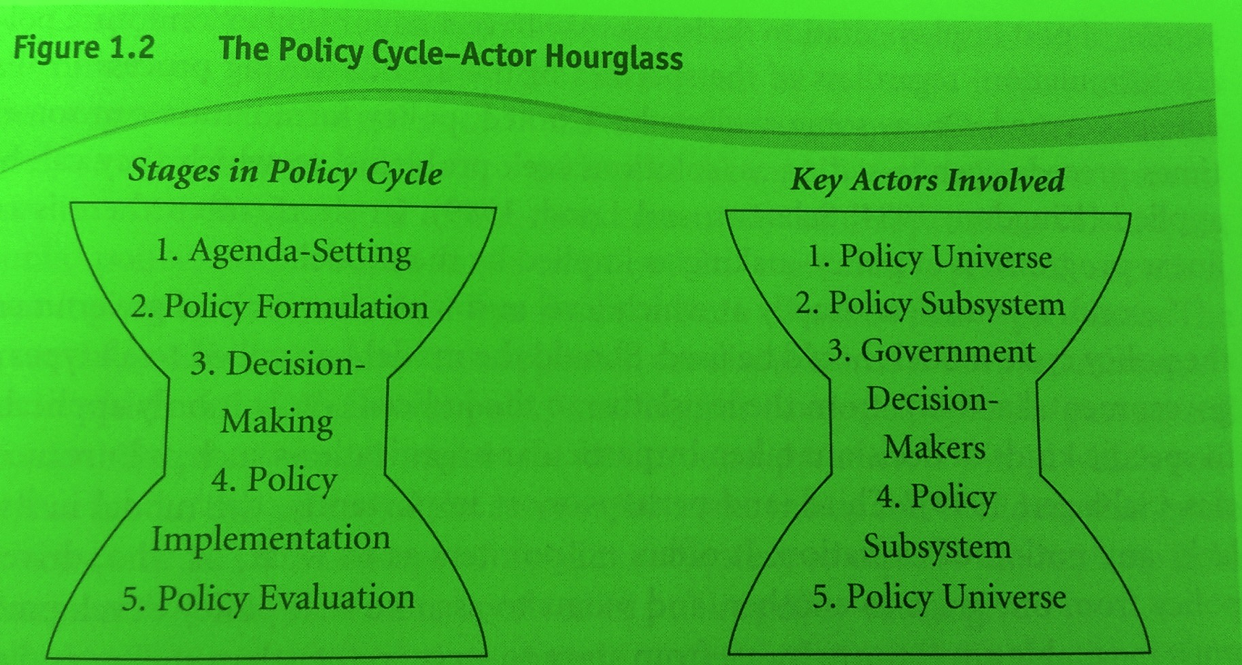
The Five-stage Policy Cycle Howlett et al. (2009)
Howlett, M et al. (2009), p 13.

Slide 5
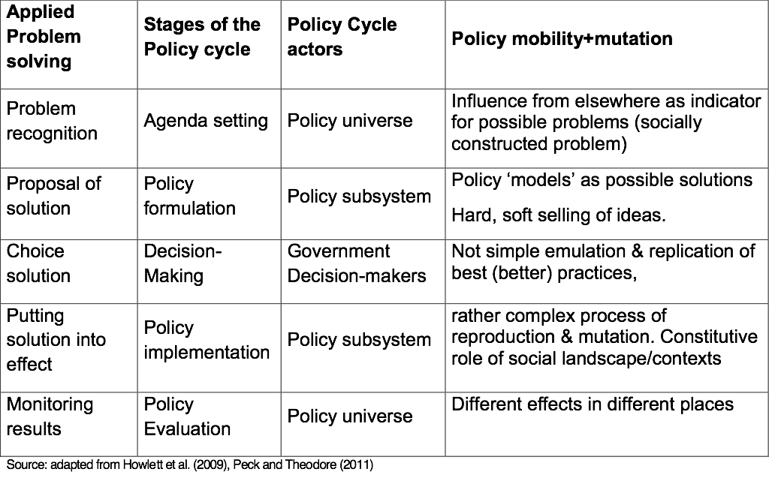

Slide 6
Literature in Comparative education about Policy travel
Cowen (2009): ‘as it moves, it morphs’
transfer, translation, transformation and
shape-shifting: geographic immobility and mobilities of shape
Steiner –Khamsi (2012): critical moment of transfer
Bacchi (2000, 2009), Taylor (1997, 2004): from problem-solving to problem-questioning, policy as discourse, researching educational policy using critical discourse analysis.

