Slide 1
Rankers Looking in: What do Global University Rakers do?
Miguel Lim
mili@au.edu.dk
Aarhus University

Slide 2
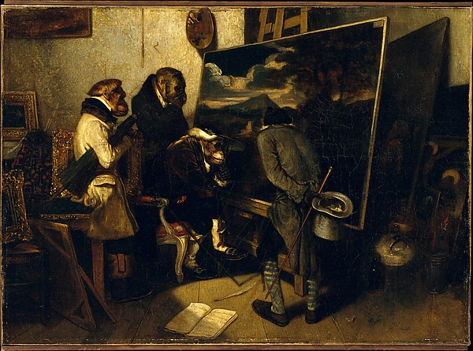
”The Experts”
Alexandre-Gabriel Descamps
(1837)
Notes:
Gap in HE lit is about those who make the rankings. Everyone is interested in impact.
Finding out who makes the rankings helps us to understand impact.
Unis don’t necessarily know the rankings well. They pick the one that shows them in their best light. E.g. IoE and QS.

Slide 3
Presentation
Research Context: concern over impact
Research Question: What do they do?... Who are they?
Case Study: THE and Shanghai Jiao Tong ARWU Rankings
Discussion
Notes:
Who are the rankers: sets up the following questions: what do they do and why do they do what they do.

Slide 4
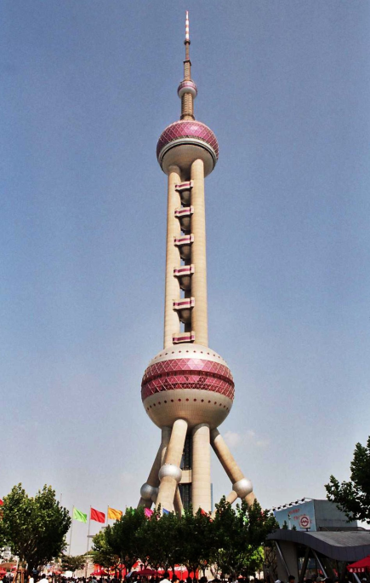
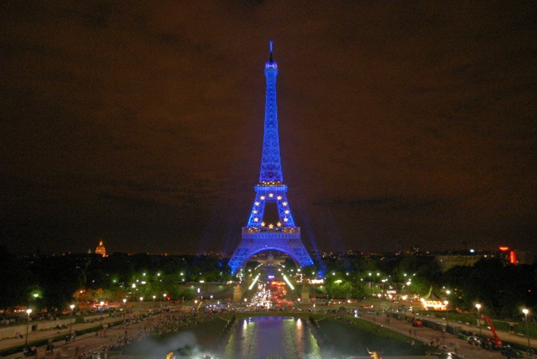
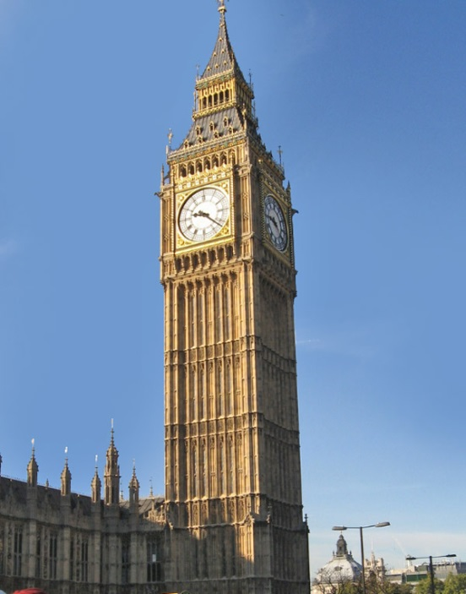
Who are the Global Rankers?
Notes:
Difference between a ranking made by an academic department, a newspaper, and a business.

Slide 5
What they do <> Who they are
Importance of organizational histories, organizational narratives, core audiences, business models, etc.
Importance of individual histories, narratives…

Slide 6
Theory
Rankings as instruments and mechanisms of governance
‘Bearers of values’ (Lascoumes and Legales, 2007)
Rankings and power (Pusser and Marginson, 2009; Erkilla and Piironen, 2013)
The device ‘defines the nature of the effect’ (Dale, 1999, 2)
Notes:
‘When rankings are at work they are not purely technical.’
‘Rankings are material devices whose production involves many choices on the part of those who produce them’
The vision of the ideal university inherent in each device.
Practical and ideological aspects of ranking methodologies (p. 8).

Slide 7
Theory
Asking the question who they are and what they do
What do we gain by asking such ‘basic questions’?
Allows for nuance when we speak of rankings
Allows for thinking about policy instruments without being overdetermined by ‘big’ governmental discourses
e.g. ‘big NL’ (neoliberalism)
Notes:
‘When rankings are at work they are not purely technical.’
‘Rankings are material devices whose production involves many choices on the part of those who produce them’
The vision of the ideal university inherent in each device.
Practical and ideological aspects of ranking methodologies (p. 8).

Slide 8
Method
Data Collection
Desk research
Conferences (SJTU WCU-5, Universitas 21 Conference, IREG London, QS London Graduate Fair, QS TopMBA Fair)
Interviews (19): Conferences, Shanghai Jiao Tong University - Mingham Campus, SJTU (London) presentation, THE offices
Extended ‘quasi secondment’: THE (London, July 2014-November 2014)
Collection ongoing
Notes:
‘When rankings are at work they are not purely technical.’
‘Rankings are material devices whose production involves many choices on the part of those who produce them’
The vision of the ideal university inherent in each device.
Practical and ideological aspects of ranking methodologies (p. 8).

Slide 9
Case: SJTU ARWU
ARWU developed as an internal benchmarking tool
Response to Chinese Government Plan 985
First published in 2003, after interest from European academics (Liu, 2009)
Nian Cai Liu: Chemical Engineering background
Academic Exercise
No particular audience
Reluctance to be seen as a commercial enterprise
Notes:
Liu’s accidental participation in SJTU strategic planning exercise.
Benchmarking questions:
‘What is the definition of a world class university? What are the positions of top Chinese universities in the world system? How can top Chinese universities reduce their gap with world class universities?’ – ARWU is a distance measuring device.

Slide 10
Case: THE
Originally THE-QS
Commercial enterprise; QS data analysis, THE media outlet
First published in 2004
‘Divorce’ from QS in 2009
First THE rankings in 2010
Phil Baty: investigative journalism background
Targeted audience of THE: ‘sector’ leaders, vice chancellors, policy makers
Notes:
Liu’s accidental participation in SJTU strategic planning exercise.
Benchmarking questions:
‘What is the definition of a world class university? What are the positions of top Chinese universities in the world system? How can top Chinese universities reduce their gap with world class universities?’ – ARWU is a distance measuring device.

Slide 11
Critique: THE, SJTU ARWU
Academic Critique of rankings
On method (van Raan, 2005)
On ‘neoliberalism’ (Naidoo, 2005)
Destructive nature on Higher Education’s mission (Kehm, 2014)

Slide 12
Critique: SJTU ARWU and THE
ARWU: Political ‘Critique’
Chinese Government pressure to shut down ARWU
Dissatisfaction from other countries’ governments and ‘World Class’ universities in other countries
THE: Academic Community ‘Critique’
Academics and University managers unhappy with rankings
e.g. ‘Younger’ Univeristies complaints

Slide 13
Response: SJTU ARWU and THE
ARWU: Political ‘Critique’
ARWU produced by the SJT Consultancy since 2009
SJTU Team previously tried to set up an NGO (as early as 2004)
Paradox: ‘business’ set-up protects academic expression
THE: Academic Community ‘Critique’
Divorce from QS, Creation of own rankings
Change of methodology, ‘normalisation’ of citation data

Slide 14
Discussion
 | SJTU ARWU | THE
Organization set up | Academic department then Consulting Group | Media / Newsletter (Previous partnership with Consulting group)
Principal Actor(s) | Nian Cai Liu Chemical Engineering | Phil Baty Investigative Journalism
Audience | None stated | Thought leaders / Policy Community
Metrics | ‘Objective’; only third party generated | Survey data and other metrics (13 areas)
Interaction with universities | None; organizes semi-annual WCU conference | Annual reputation survey; Various and growing number of THE events; THE awards in UK
Data partner | Thomson Reuters | Thomson Reuters, recent shift to Elsevier

Slide 15
Discussion
Knowing who the rankers are helps us to understand methodology (and differences with other rankers)
Knowing who the rankers are helps us to understand potential impact (with policy implications)

Slide 16
End of Presentation
Thank you
Miguel Lim
mili@au.edu.dk
This research is supported by an EC Framework 7 Grant (Marie Curie Actions) and the UNIKE project.

